Slide 1
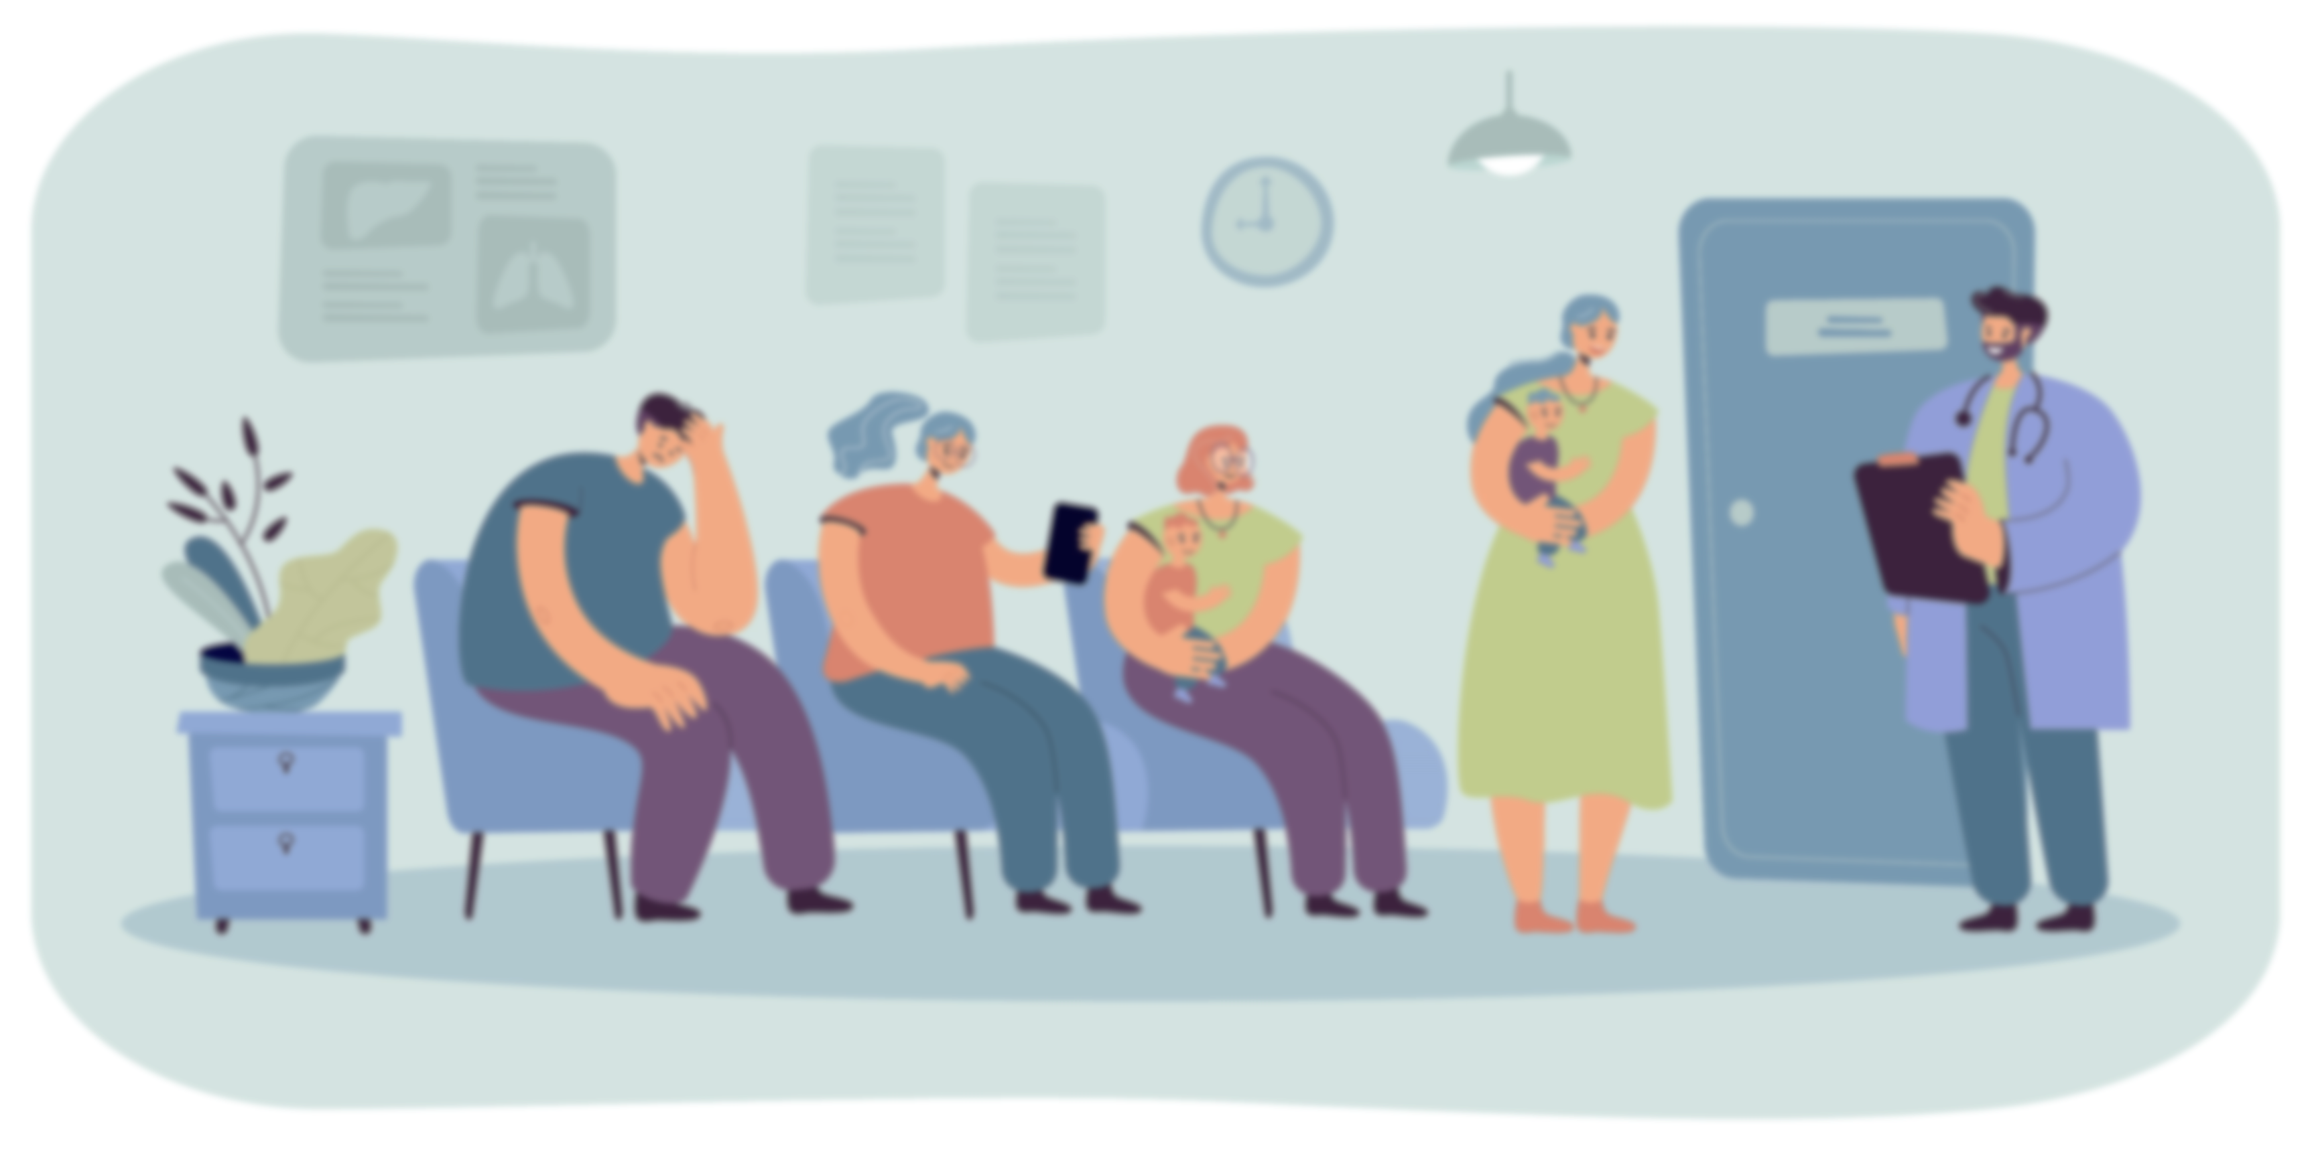
Ambience Technology (Patient – Doctor Encounter)
Presented by: Muhammad Hamza Qaisar

Slide 2
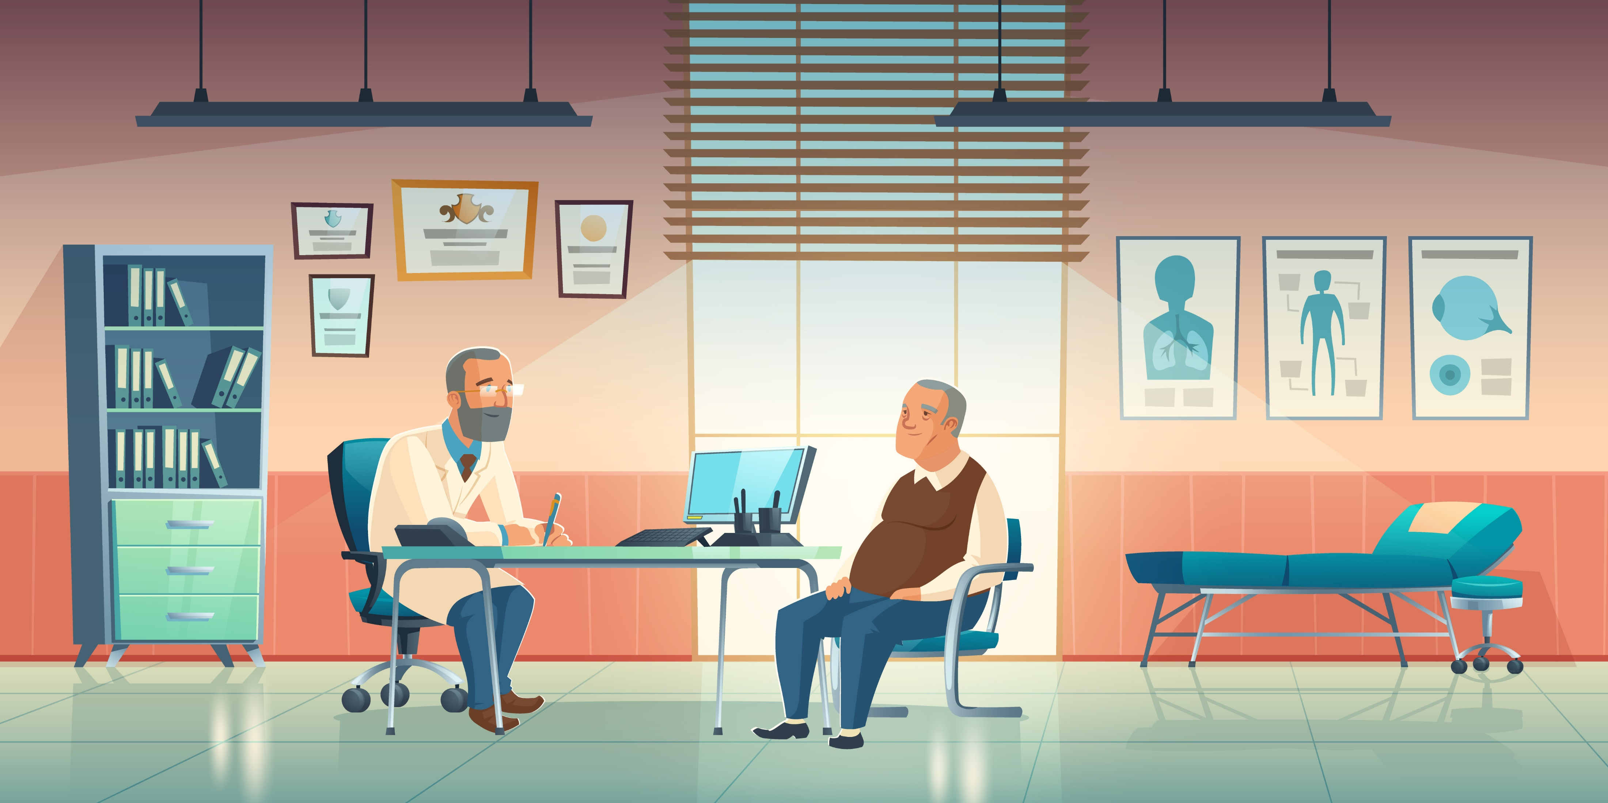
Introduction
Imagine if your next visit to the doctor was like having a conversation with a trusted friend, who knows everything about your health history, concerns and preferences. What if every word you said was recorded, transcribed and analyzed by a computer program, providing you with personalized insights and recommendations tailored just for you?
That’s a great idea.
But how?

Slide 3
Background
Healthcare delivery is determined by the interaction between healthcare providers and patients.
Patient-doctor encounter is crucial for diagnosis, treatment, and ongoing care.
Effective communication is essential for patient-centered care.
Time constraints and competing demands can limit the quality of the interaction.
Ambience technology uses speech recognition, AI/ML, and a database to extract valuable data from patient-doctor conversations.
Ambience technology has the potential to improve the patient-doctor encounter by providing real-time feedback, recommendations, and personalized care plans based on insights extracted from conversations.
The use of speech recognition and AI/ML in patient-doctor encounters is a relatively new and unexplored area of research
Investigating the effectiveness of Ambience technology is important to enhance the overall patient experience and improve the quality of healthcare delivery.

Slide 4
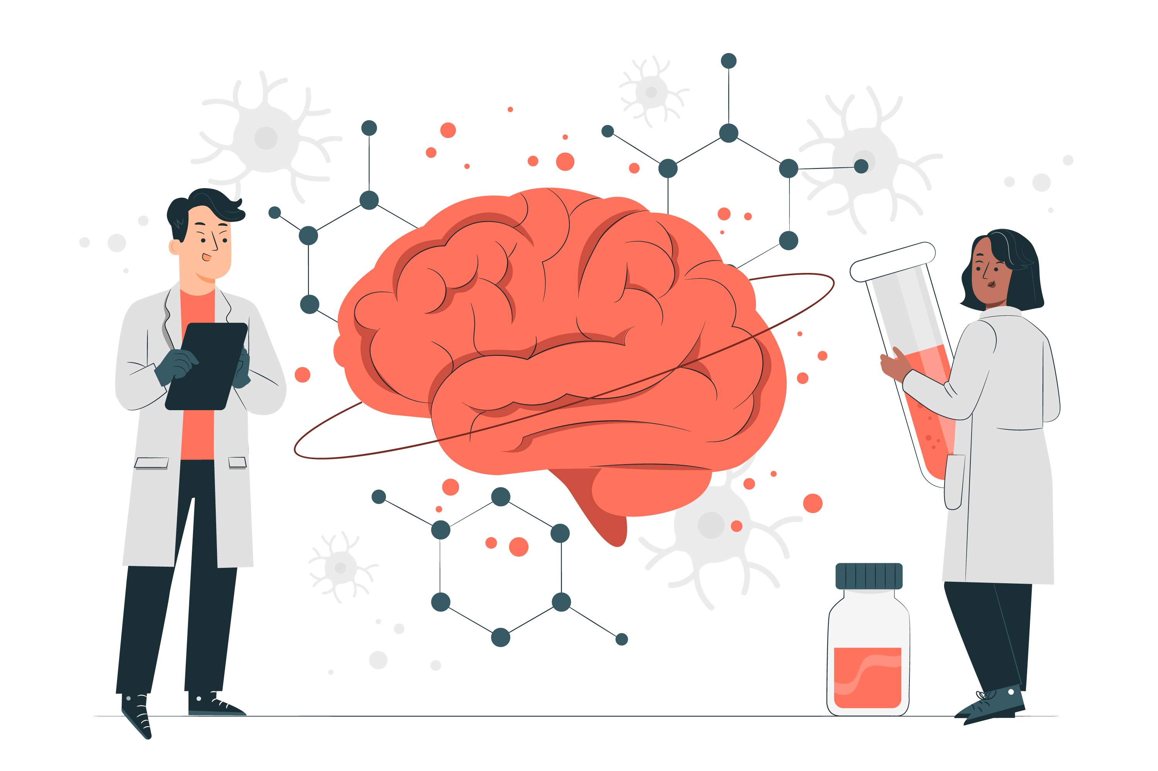
NLP (Natural Language Processing)
NLP is about teaching computers to understand and use language like humans do.
This can be used for a variety of applications, from chatbots and virtual assistants to language translation and sentiment analysis. With NLP, computers can process, analyze, and generate human language, making it possible for us to interact with them in a more natural way.

Slide 5
NLP Process
Step 1:
Segmentation
Break data into sentences
Step 2:
Tokenizing
Break sentence into words
Step 3:
Stemming
Same words with different prefix or suffix
Step 4: Lemmatization Learning that multiple words can have the same meaning (is, am, are = be)
Step 5:
Stop Words
Mark down 'Verb to be., prepositions etc.'
Step 6:
Speech Tagging Adding tags to words (noun, verb, preposition)
Step 7:
Name Entity Tagging Introduce machine to some group of words that may occur in documents
Step 8
Machine Learning
learning the human sentiment and speech.

Slide 6
Deep learning and Hidden Markov Method:
Hidden Markov Models (HMMs)
are a statistical model used in speech recognition to model the temporal structure of speech. They work by dividing the speech signal into small frames and modeling the probability distribution of each frame given the underlying phoneme or word. HMMs are often used in combination with neural networks in a hybrid system to improve the accuracy of speech recognition.
Neural networks
can be used for speech recognition to map acoustic features of speech to corresponding phonemes or words, improving the accuracy of speech recognition systems. They are trained on large datasets of labeled speech samples and can be part of a hybrid system that combines multiple techniques for improved performance.

Slide 7

Problem Statement
A gap EHR is that it does not support the flexibility to use technology of recording patient- doctor encounter to our EHR automatically using some technique (NLP, DL, ML, AI etc.). So, to enhance the patient care and healthy conversation it is necessary to adopt this solution which will not only increase efficiency of the conversation but the time of recording will also be minimized. This way doctor can access more patients which in term increases the productivity of the entire system (ROI).

Slide 8
Methodology
Our own
Potential Vendors

Slide 9
Potential Vendors:
Products | Security | Performance | Usability | Medical terms Knowledge
Nuance DAX Ambient | HIPPA Compliance | Real time | User-friendly | Don’t provide any suggestions related to the medical terms
Nvoq Voice Sayit | HIPAA compliance | Real time | User-friendly | -
Mobius Conveyor | HIPAA and HITECH | Real time | User-friendly | -
Google Speech-to-text and AutoML | Not HIPPA Compliance but can be made to meet the requirement | Real time | Training required | We need to train and integrate the two products to make it work
IBM Watson Speech-to-text | Not inherently HIPPA Compliance, can be made. IBM offers a HIPAA-ready configuration for Watson | Real time | Training required | We need to train and integrate the two products to make it work

Slide 10

Best Model:
Amazon Transcribe and comprehend:
Automatic speech recognizes service that makes it easy for you to add medical speech-to-text capabilities to your voice-enabled applications. Conversations between health care providers and patients provide the foundation of a patient’s diagnosis and treatment plan and clinical documentation workflow. It’s critically important that this information is accurate.
HIPPA Compliance
For primary and specialty care areas such as cardiology, neurology, obstetrics-gynecology, pediatrics, oncology, radiology and urology
Transcribes medical terminologies such as medicine names, procedures, and even conditions or diseases.
For use cases such as transcribing physician-patient conversations for clinical documentation, capturing phone calls in pharmacovigilance, or subtitling telehealth consultations.

Slide 11

Benefits
Save time with highly accurate transcriptions.
Lower medical transcription costs.
Ease of use.
Data security and privacy.

Slide 12

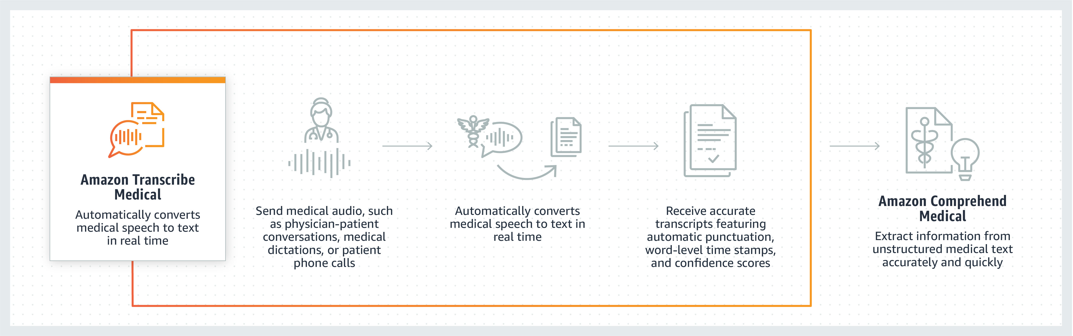
How it works?

Slide 13

Use Cases:
Conversational voice scribes
Healthcare and life science customers can build transcription applications that capture physician-patient conversations in real time, without disrupting the interaction. Transcripts can be processed using downstream text analytics to identify key entities like medication, dosage, strength, and frequency, before final entry into electronic health record (EHR) systems.
Medical dictation applications
Use Amazon Transcribe Medical to build voice applications that enable physicians to dictate medical notes, helping to reduce the burden of clinical documentation so that they can focus on delivery quality patient care.
Drug safety monitoring
Pharmaceutical companies can use Amazon Transcribe Medical to transcribe phone calls that report on drug safety and side effects. Customers can efficiently integrate with the service to deploy their pharmacovigilance solutions across large-scale contact centers.

Slide 14
Our Own Solution:
For our solution, we need a person who has sound knowledge of what NLP is. To make our own system we need a full fledge product which may be costly but it will deliver the function that we want it to do. There will be no security issue as it will be the product only for our own benefit. But this can be scaled to introduce a new product in the market. We need to be better than those products mentioned above but accurate too. So, accuracy, security, medical terms knowledge, usability is the four main things we need to consider while making our own product. This may require a good microphone too.
What I suggest, is to use one of those solution by contacting them and telling them what we need and contracts to use those products. We can use trial version of those products and check for accuracy and performance overall and do the cost analysis accordingly.

Slide 15
Conclusion
Ambience technology has the potential to transform the patient-doctor encounter by providing real-time feedback, recommendations, and personalized care plans based on insights extracted from conversations
Our study found that Ambience technology has the potential to improve patient satisfaction, enhance the quality of care, and reduce medical errors
There are still some barriers and challenges to the implementation of this technology in clinical practice that need to be addressed in future research
The development and implementation of Ambience technology in patient-doctor encounters is an exciting and innovative approach that has the potential to transform healthcare delivery
With further research and development, Ambience technology can provide personalized and patient-centered care, improve healthcare outcomes, and enhance the overall patient experience

Slide 16
Acknowledgments

Slide 17
Thank you

